Slide 1
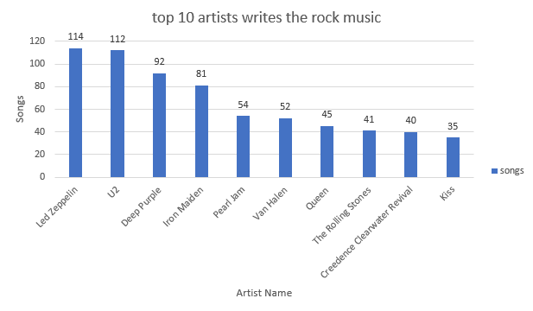
Who write the rock music?
As we see The top 10 bands are shown below along with the number of songs each band has on record
The first place led zeppelin with 114 songs

Slide 2
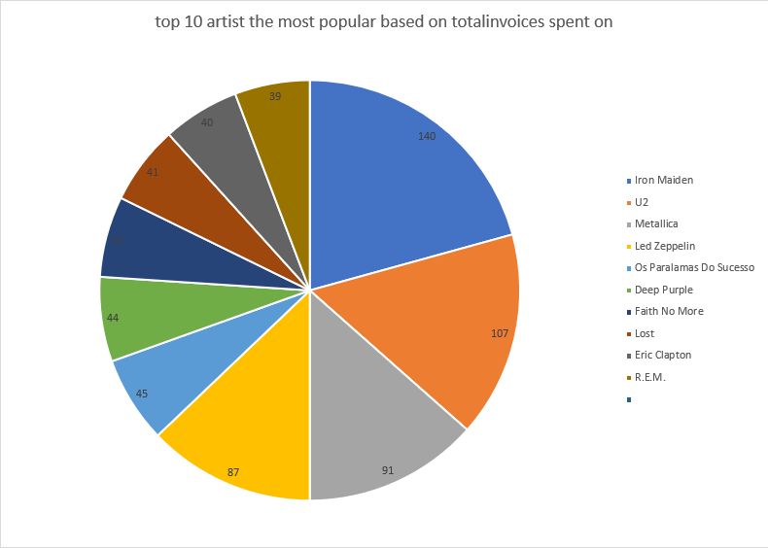
what are the most popular artists ?
<visualization>
We can see that iron maiden the most popular with 140 invoices
The qurey limits only top 10 artists
Top 3 artist invoices equal to the other 7 artists = 338 and that’s a good insight

Slide 3
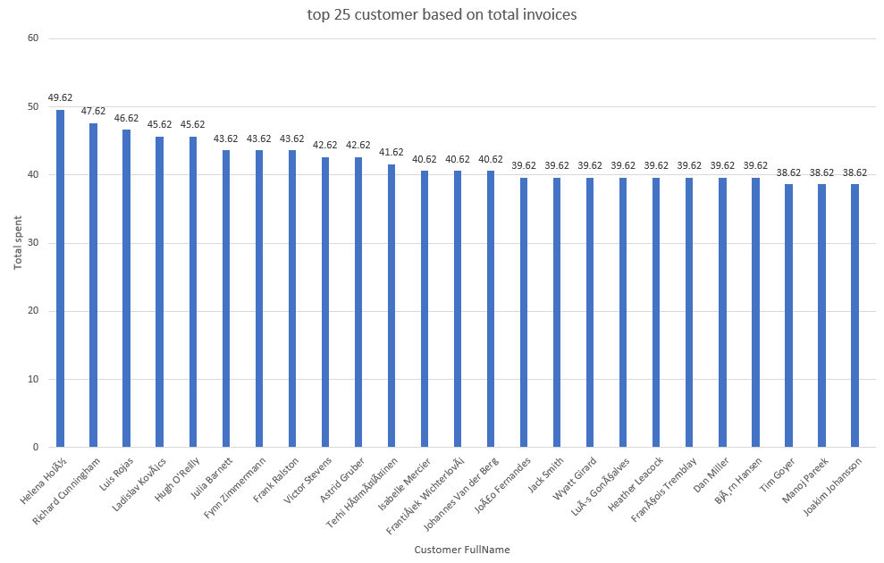
what are the total invoices spent on by customer ?
<visualization>
As we see here that the total spent by customer really, close to each other
The qurey limits only top 25 customers

Slide 4
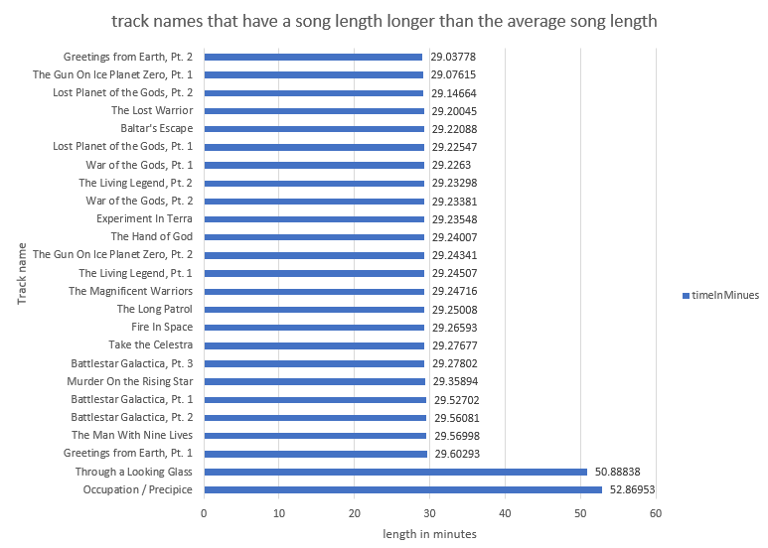
which track names that have a song length longer than the average song length ?
<visualization>
Return all the track names that have a song length longer than the average song length
We notice that top 2 more that 50 min,and the other tracks less that 30 min
The qurey generates 494 track name but we limits 25 to make it good for visualization

